Slide 1
XML Databases and Effective Search Engine

Slide 2
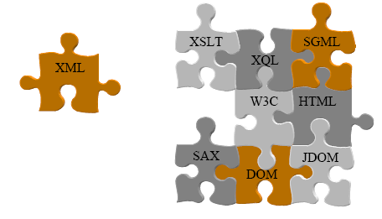
XML
Extensible Markup Language is a meta-language that describes the contents of the document
(Self-describing data)
JAVA=Portable Code
XML=Portable Data

Slide 3
Applications of XML
Configuration Files
used extensively in J2EE architectures
Media for data interchange
A better alternative to proprietary data formats
B2B Transactions on the Web
Electronic Business orders (ebXML)
Financial Exchange
Message Exchange (SOAP)

Slide 4
Four tasks of data management
The basic tasks of data management do not change simply because the data are stored in XML
Store
Search
Retrieve
Display

Slide 5
XML a Database ?
Only in the strictest sense of the term
It is self-describing
It is portable
It can describe data in tree or graph structures

Slide 6
XML a “ Sort of ” Database ?
Storage -- XML documents
Schemas -- DTDs, XML Schemas, and so on
Query languages -- XQuery, XQL, etc.
Programming interfaces -- SAX, DOM

Slide 7
XML lacks........
Efficient storage
Indexes
Security
Transactions and data integrity
Multi-user access
Triggers
Queries across multiple documents

Slide 8
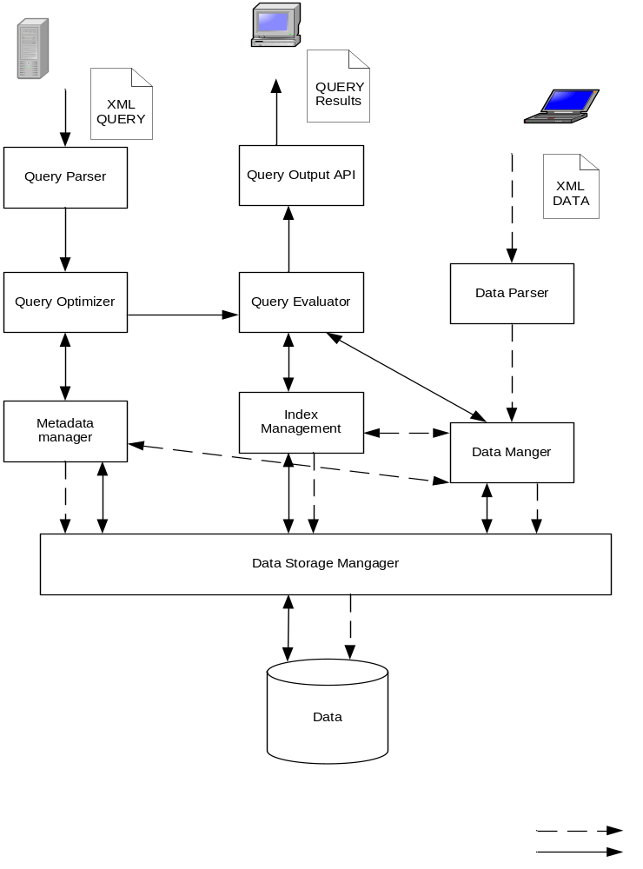
XML Database Architecture

Slide 9
XML Databases
RDBMS s that support XML e.g. Oracle , DB2
Native XML Database e.g. Apache Xindice, Stanford XMLDB

Slide 10
Relational Databases Vs XML Databases
Relational database | XML database
A relational database contains tables. | An XML database contains collections.
A relational table contains records with the same schema. | A collection contains XML documents with the same schema.
A relational record is an unordered list of named values. | An XML document is a tree of nodes.
A SQL query returns an unordered set of records. | An XQuery returns an ordered sequence of nodes.

Slide 11
Technologies
Java - Servlets, JAXP
Apache Tomcat web server
Apache Xindice XML DB
RDBMS - MS-Access, MY-SQL or ORACLE
IDE - Eclipse

Slide 12
Modules
Parse XML Insert into Database
Convert Database table into XML
Reflect changes in Database to XML and Vice versa

Slide 13
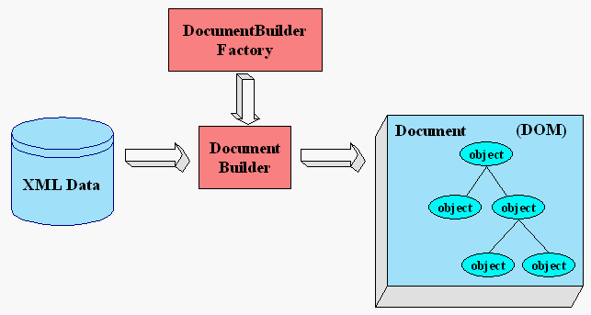
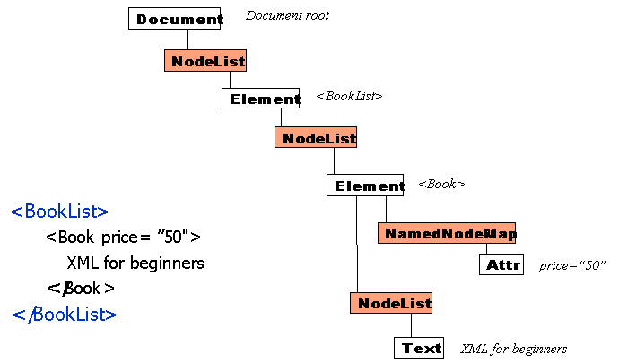
Parse XML Insert into Database

Slide 14
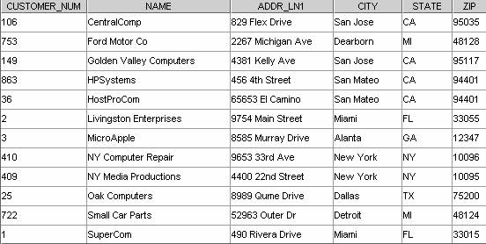
Database Table to XML

Slide 15
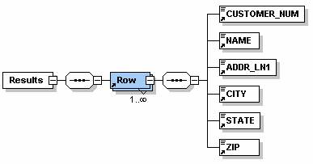
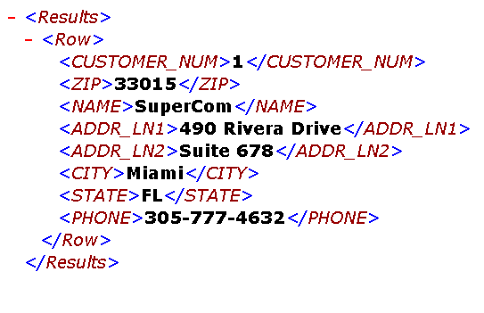
Java ResultsetMetadata
An object that can be used to get information about the types and properties of the columns in a Resultset object

Slide 16
Modules- to be Implemented
Convert Text files to XML
Convert HTML to XML
Implementing Searching
Implementing Indexing

Slide 17
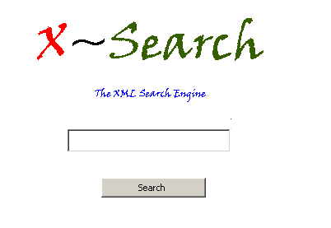
Searching XML
Search process begins in the root node
Search proceeds comparing characters in the search key to edge labels
Entering a wrong block may lead to backtracking

Slide 18
Indexing XML
The goal of indexing is to optimize the speed and performance of finding relevant documents
Without an index, the search engine would scan every document
It will take a considerable amount of time and computing power

Slide 19
Conclusions
XML can enable Effective searching
As the XML document describes itself (meta-language) it will speedup finding relevant documents

Slide 20
Thank you
XML is everywhere

